Slide 1

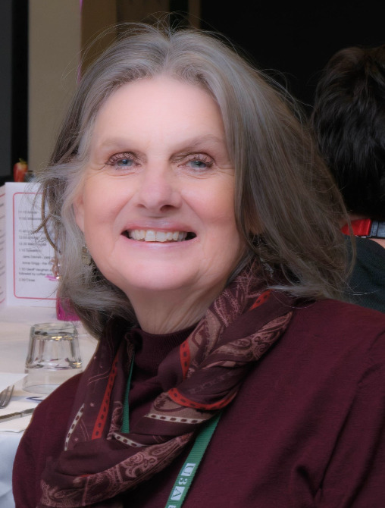
U3A Banyule President
Janet Ringrose presides over a wildly successful celebration.

Slide 2
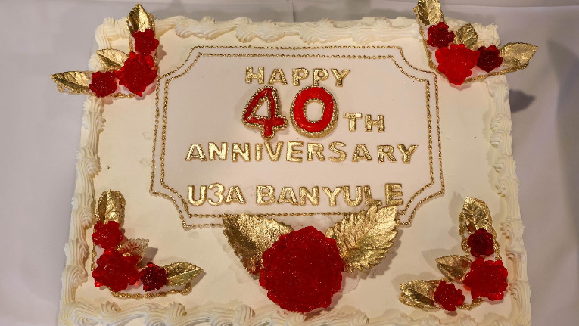
Four large sponges were required to feed the 180 guests
Happy 40th Anniversary baby

Slide 3
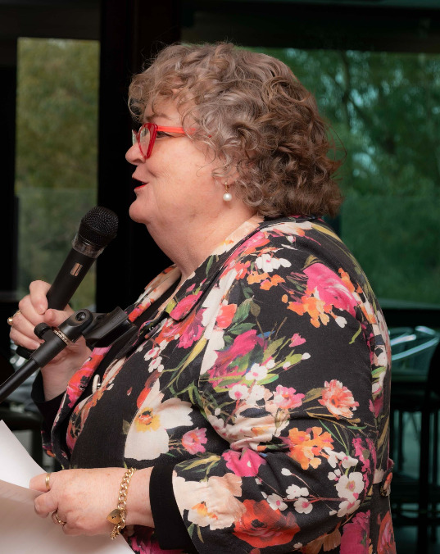
U3A Victoria Network President Anne Grigg livens us up outlining future plans

Slide 4
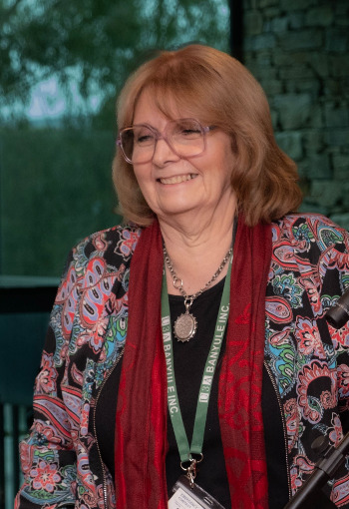
Jane Davies speaking historically.

Slide 5
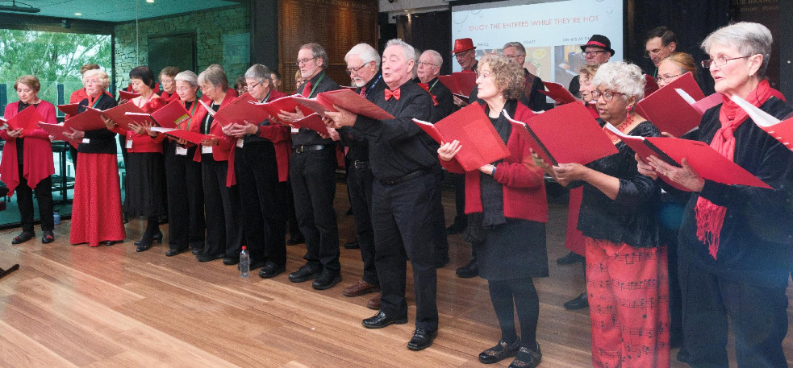
U3A Banyule Choir entertains

Slide 6
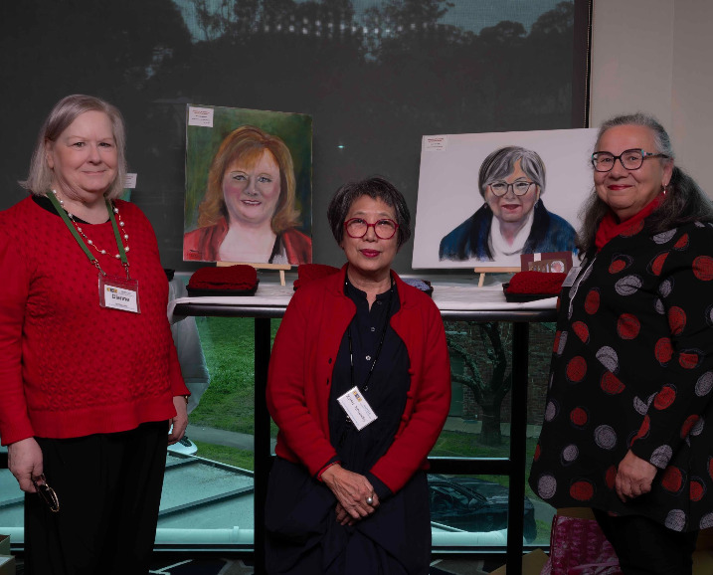
Artist Xuan Maloney with
Life members Dianne Williamson and Milena Maranville

Slide 7
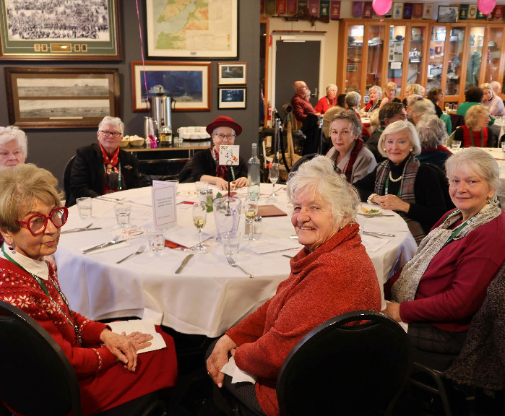

Ladies who lunch U3A Banyule style!

Slide 8
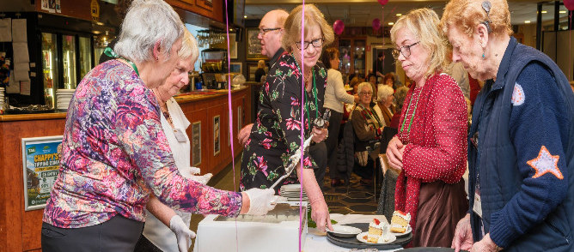
The catering team in action

Slide 9
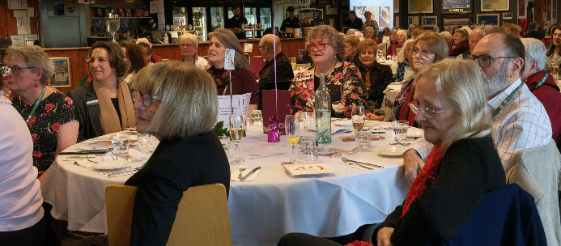
Listening to the choir

Slide 10
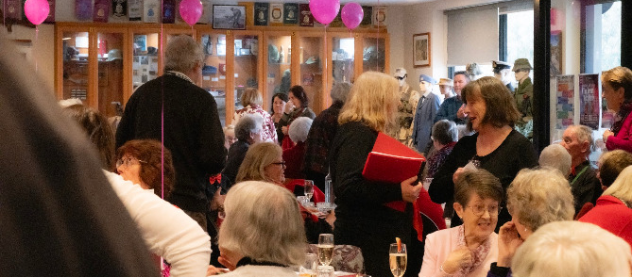
What U3A is all about!

Slide 11
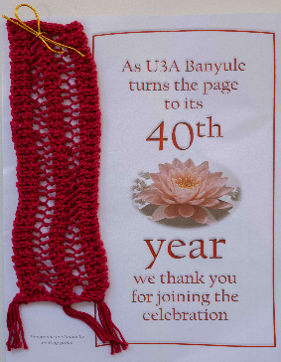
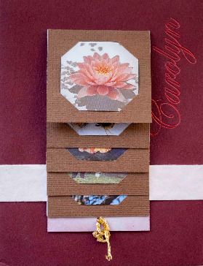
Gifts for Life members and ten years plus tutors
Bookmarks (x200) knitted and crocheted by Creative Knitting Group
Handmade thank-you cards for Life members and 10 years tutors
Hand knitted scarves for Life members and 10 years tutors
Special 40th anniversary edition booklet

